Slide 1


Slide 2

COVID-19
Project 1, Group 1
GWU Bootcamp
Prepared and Presented by:
Adal, Louie, Patricia, Raheleh, and Rasha
2/15/2023

Slide 3


COVID-19 Project Questions and Findings:
Questions that you found interesting and what motivated you to answer them
How the pandemic affected our normal lives and how to prepare for potential future pandemic spread?
Fact: In the first two years of the pandemic, COVID-19 was identified as the third leading cause of death in the United States, trailing only heart disease and cancer.
Where and how you found the data you used to answer these questions
CDC website
Downloaded raw CSV and Excel files from the CDC website
1
Notes:
Patricia

Slide 4
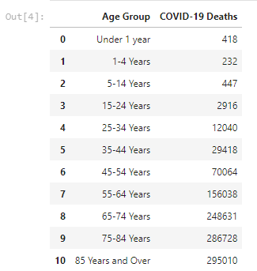
Data Exploration and Cleaning:
The data exploration and cleanup process
Fetched the data from CDC website
Saved the CSV/Excel files to our local drive
Original raw data had the information from the newest to the oldest (top to bottom). Therefore, we sorted the columns from the oldest data (e.g. 2020) at the top to the newest data at the bottom (descending order into ascending).
New column was also created to differentiate the sorting from the original data (Datetime)
Then deleted the old “date” column
Merged two csv files on “Geography” and “Date” which resulted in some Nan. As the result, we filled Nan with 0. At the end, we plotted the data.
Ignore gender and add the total COVID-19 deaths for all three years, separating them by age group. Make a DataFrame showing age group and Covid-19 Deaths. Save the new DataFrame into a .csv.
Sum, groupby, saved figs, and Chi Square test
2
Notes:
Louie
The data exploration and cleanup process (accompanied by your Jupyter notebook)
Fetched the data from CDC website
Saved the CSV/Excel files to our local drive
Original raw data had the information from the newest to the oldest (top to bottom). Therefore, we sorted the columns from the oldest data (e.g. 2020) at the top to the newest data at the bottom (descending order into ascending).
New column was also created to differentiate the sorting from the original data (Datetime)
Then deleted the old “date” column
Merged two csv files on “Geography” and “Date” which resulted in some N/A. As the result, we filled N/A with 0. At the end, we plotted the data
Ignore gender and add the total Covid-19 deaths for all three years. Separating them by age group. Make a dataframe showing age group and Covid-19 Deaths. Save the new dataframe into a .csv.
sum, groupby, saved figs, Chi Square test,

Slide 5
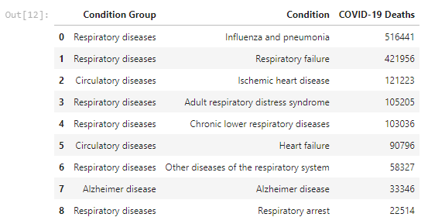
Data Exploration and Cleaning, continued
The analysis process:
After plotting using our clean data, we analyzed the following for 2020-2023:
Weekly overview of COVID Hospitalization
Weekly COVID deaths
Weekly Administered Vaccine Doses
3
Notes:
Louie

Slide 6
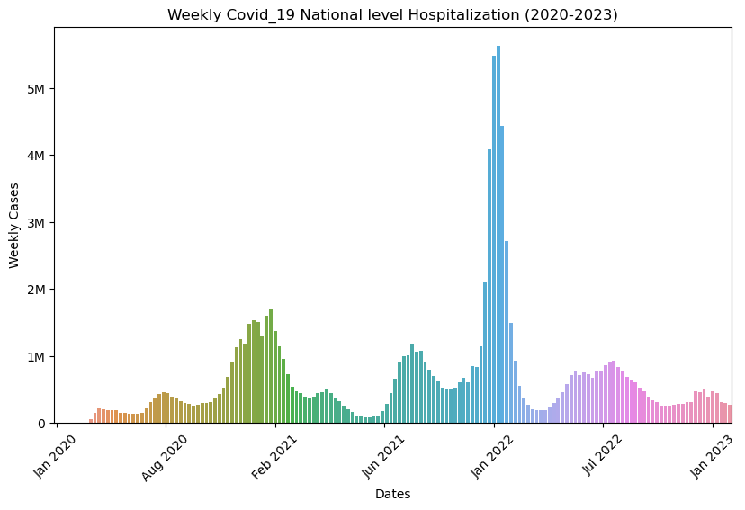
COVID Weekly Hospitalization Cases:
1- What has been the weekly COVID-19 hospitalization?
4
Notes:
Adal
The highest weekly hospitalization was during 1/19/22 (5.6M cases), Omicron started on late 11/19/21
Total cumulative hospitalization as of 2/8/23 is 102M, with current hospitalization of 23K for
In December 2022, compared to adults ages 18 years and older who received an updated COVID-19 bivalent booster dose, monthly rates of COVID-19-associated hospitalizations were 16.0x Higher in Unvaccinated and 2.7x Higher in Vaccinated Adults without an updated booster.
https://covid.cdc.gov/covid-data-tracker/#trends_weeklycases_currenthospitaladmissions_00

Slide 7
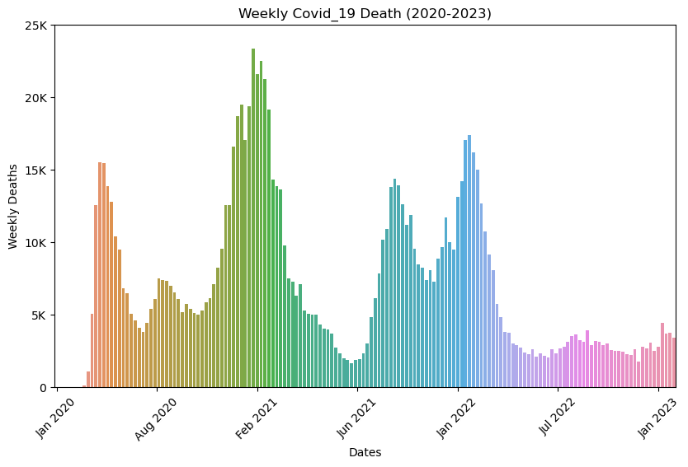
COVID Weekly Deaths
2- What has been the COVID weekly deaths?
5
Notes:
Adal
Highest number of death was on the week of 1/31/21 (7.04 per 100K population)
Total # of death 1.1M in the U.S.A (total cases worldwide were 673M and deaths were 6.58M, that is 1% deaths)
https://covid.cdc.gov/covid-data-tracker/#trends_weeklycases_7daydeathsper100k_00

Slide 8
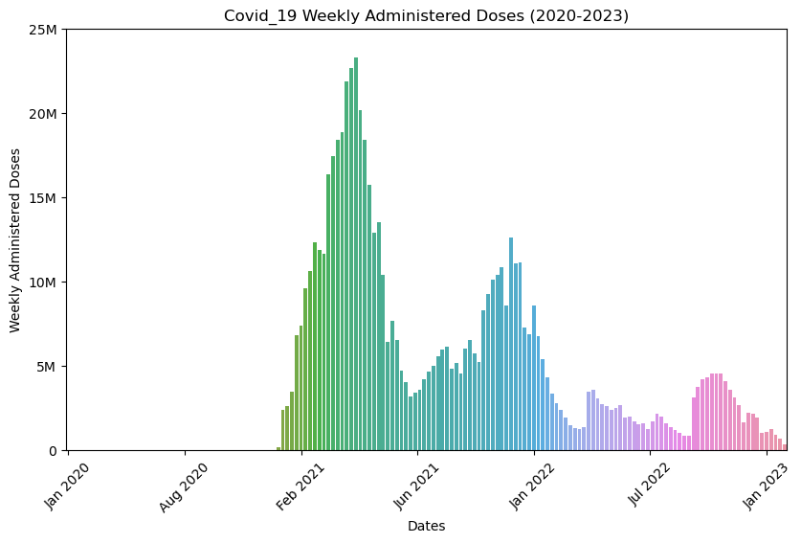
COVID Weekly Vaccination Administered:
3- What has been the weekly COVID-19 vaccination administered?
6
Notes:
Adal
Vaccination in the U.S. started on 12/9/20
Highest vaccination per week happened on 4/14/21 at 23.3M doses
Total cumulative vaccination administered in the U.S.A are 670.3M
https://covid.cdc.gov/covid-data-tracker/#trends_weeklycases_7daytotaldailyvaccdoses_00

Slide 9
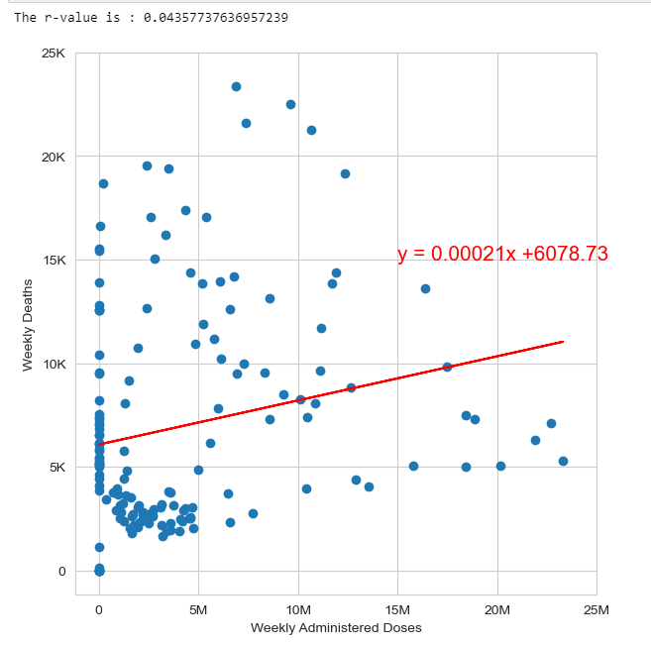
COVID Weekly Vaccination Administered:
4- What has been the weekly COVID-19 vaccination administered? Continued
7
Notes:
Adal
Due to Pearson’s Correlation--r value is about 0.2 which is less than 0.3. Therefore, the correlation between weekly deaths and weekly administered doses are very weak or none

Slide 10
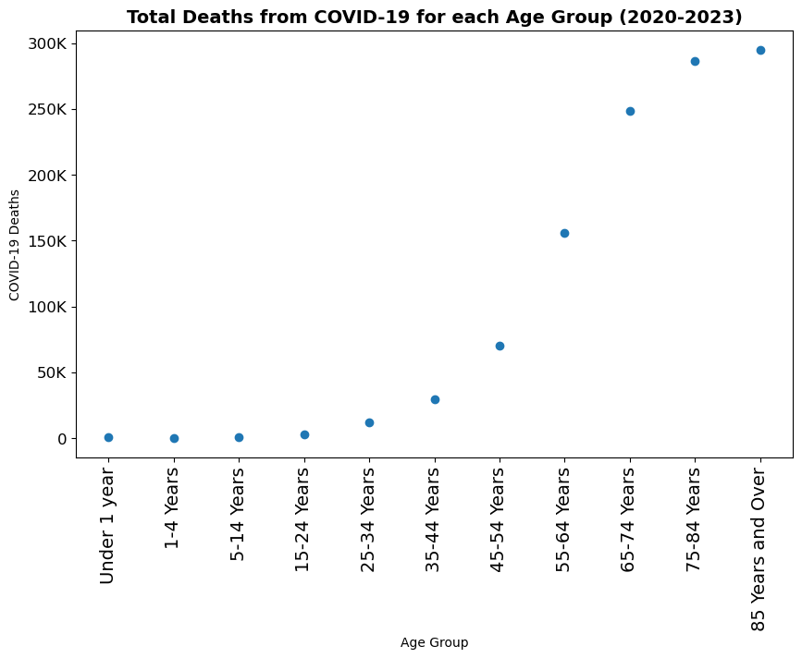
COVID Total Deaths per Age Group:
5- What have been the relationship between age group and COVID-19 deaths?
8
Notes:
Rasha
As the age group increases, the number of deaths also increase
Total deaths were highest among 85 years and older, 295K. The previous age group, 75-84, was also closed to 85 years old as far as # of deaths
https://covid.cdc.gov/covid-data-tracker/#demographics

Slide 11
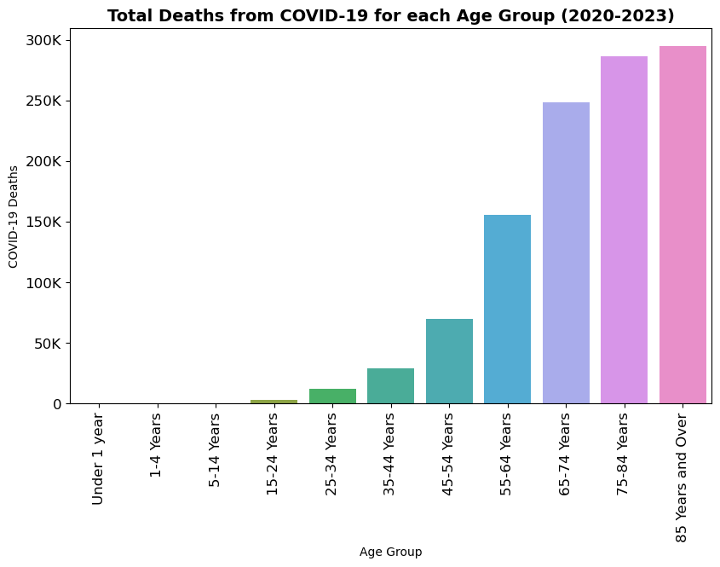
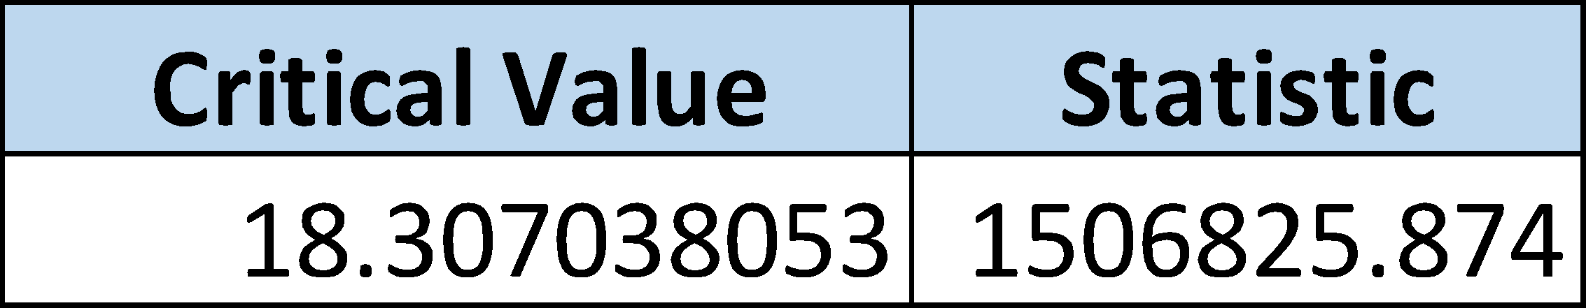
COVID Total Deaths per Age Group (Chi Square Test)
6- What does the Chi Square Test Reveal for the Number of COVID Deaths by Age?
Null Hypothesis: Deaths from COVID-19 do not vary by age group
Alternate Hypothesis: Deaths vary based on age group
Based on this analysis, we reject the Null Hypothesis
9
Notes:
Rasha
With the Chi Square Test, Critical Value of 18.31 shows that the statistics are very significant. Null hypothesis is rejected and your statistical is significantly different. We expected the total deaths would be the same across all age groups (100,176). However, the test shows that our expectation was far from reality
Total deaths: 1.1M
Expected COVID-19 Deaths: 100,176.55

Slide 12
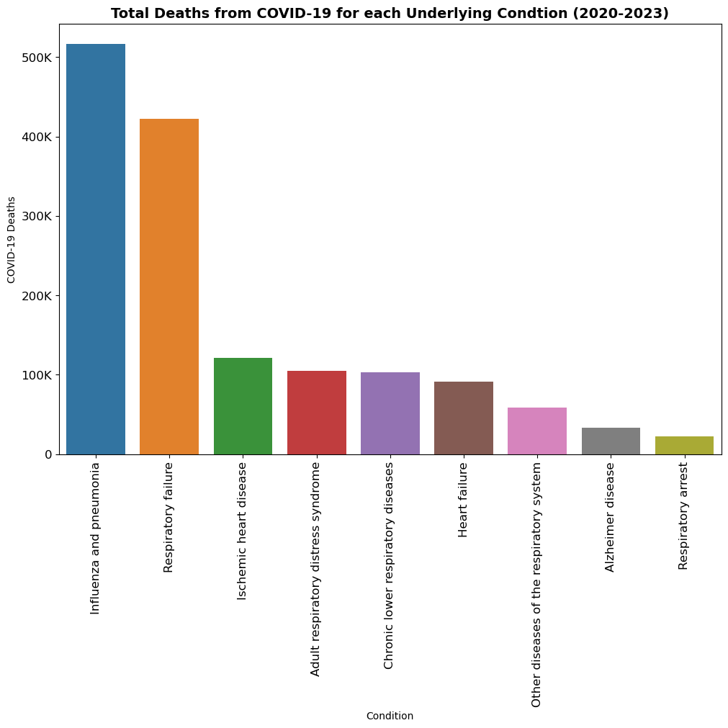
COVID Underlying Disease and Deaths
7- What Is the Relationship of Underlying Diseases with the Number of COVID Deaths?
10
Notes:
Louie
Top 5 diseases are Influenza and pneumonia, Respiratory failure, Hypertensive diseases, Diabetes, and Cardiac arrest
We need to double check the numbers on this. I see the total death to be on 6.1M for the 5 top diseases while the total deaths in the U.S.A was only 1M. Can this be cumulative numbers from the world?

Slide 13
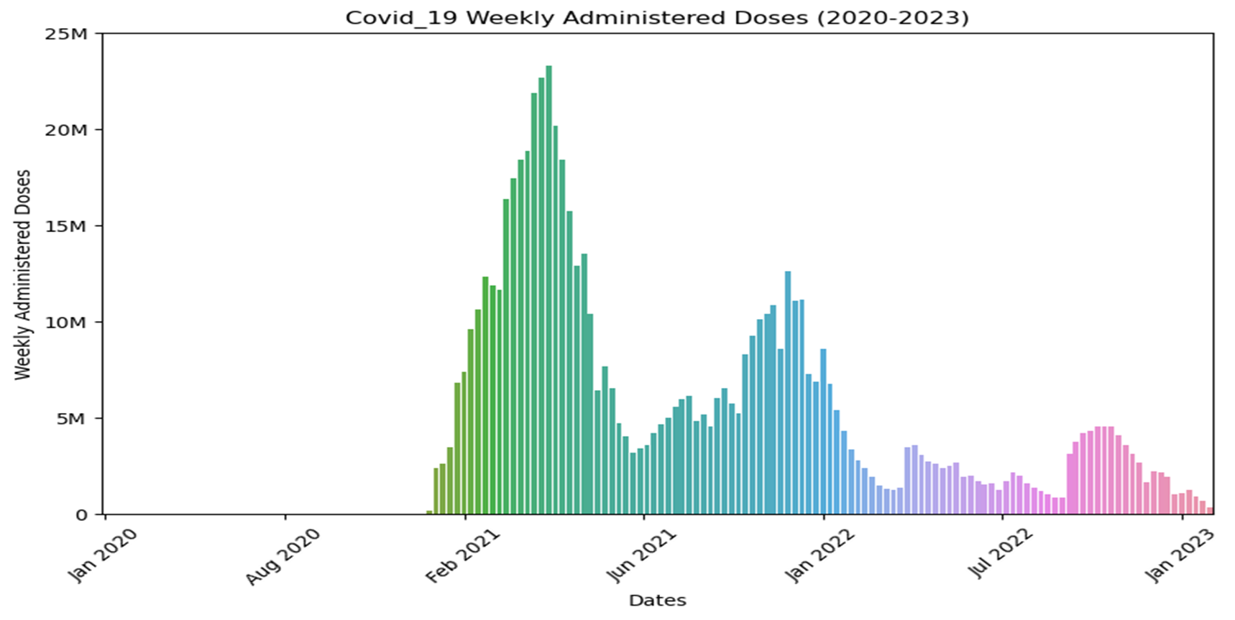
Conclusions: Including Visualization
Vaccination drastically reduced the number of the deaths when initially was administered Dec 2020-March 2021
11
Notes:
Raheleh
https://www.cdc.gov/coronavirus/2019-ncov/science/data-review/index.html
Several factors have led to changing patterns of COVID-19 morbidity and mortality over the course of the pandemic, including the introduction and widespread availability of COVID-19 vaccines, high population prevalence of infection-induced immunity, increased availability of effective COVID-19 outpatient treatment, and changes in the SARS-CoV-2 virus itself.
Although overall COVID-19–related mortality rates declined, adults aged ≥65 years continued to have the highest mortality rates
COVID-19 was reported as the underlying cause of death for most COVID-19–related deaths. However, a higher proportion of COVID-19–related deaths had COVID-19 listed as a contributing cause of death during January–September 2022 compared to previous years of the pandemic

Slide 14
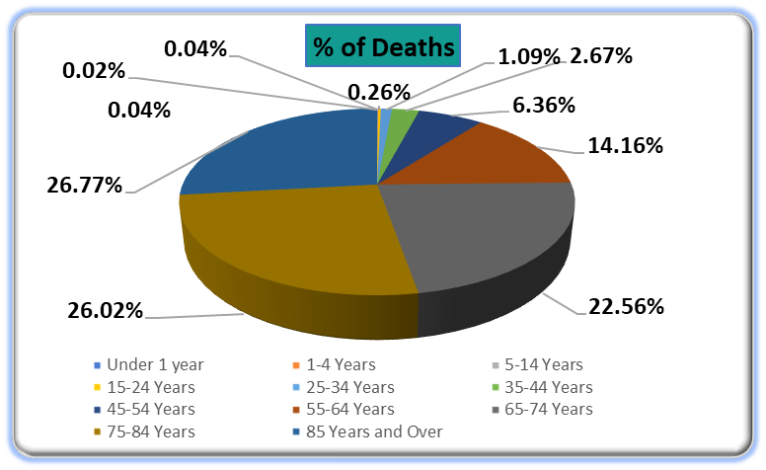
Conclusions: Including Visualization
Age is a significant factor in mortality rate
Percentage of deaths with people aged 55 and older consisted of 89% of total COVID-19 deaths
12
Notes:
Raheleh
https://www.cdc.gov/coronavirus/2019-ncov/science/data-review/index.html
Several factors have led to changing patterns of COVID-19 morbidity and mortality over the course of the pandemic, including the introduction and widespread availability of COVID-19 vaccines, high population prevalence of infection-induced immunity, increased availability of effective COVID-19 outpatient treatment, and changes in the SARS-CoV-2 virus itself.
Although overall COVID-19–related mortality rates declined, adults aged ≥65 years continued to have the highest mortality rates
COVID-19 was reported as the underlying cause of death for most COVID-19–related deaths. However, a higher proportion of COVID-19–related deaths had COVID-19 listed as a contributing cause of death during January–September 2022 compared to previous years of the pandemic

Slide 15
The Implications of Our Findings: Our Findings Mean
In case of potential future pandemic outbreak, we recommend:
Social distancing and stay at home until vaccination is available
Vaccination to be available to people with underlying respiratory conditions and 55 years and older
13
Notes:
Raheleh
https://www.cdc.gov/coronavirus/2019-ncov/science/data-review/index.html
Although this pandemic's vaccination was initially available to people over 65, we recommend that in future the vaccination be available to people with underlying respiratory and 55 years and older

Slide 16
Summary Write-up of Findings:
1- What has been the weekly COVID-19 hospitalization?
The highest weekly hospitalization was during 1/19/22 (5.6M cases), Omicron started on late 11/19/21. Total cumulative hospitalization as of 2/8/23 is 102M, with current hospitalization of 23K (Slide# 4 (page #)- Plot)
2- What has been the COVID weekly deaths?
Highest number of death was on the week of 1/31/21 (7.04 per 100K population)
Total # of death 1.1M in the U.S.A (total cases worldwide were 673M and deaths were 6.58M, that is 1% deaths) (Slide# 5 (page#)- Plot)
3 and 4- What has been the weekly COVID-19 vaccination administered?
Vaccination in the U.S. started on 12/9/20
Highest vaccination per week happened on 4/14/21 at 23.3M doses
Total cumulative vaccination administered in the U.S.A are 670.3M (Slide# 6 and 7 (page#)-Plot)
5- What have been the relationship between age group and COVID-19 deaths?
Due to Pearson’s Correlation--r value is about 0.2 which is less than 0.3. Therefore, the correlation between weekly deaths and weekly administered doses are very weak or none
89% of COVID deaths were among people aged 55 years and older (Slide# 8 (page#)-Plot)
6- What does the Chi Square Test Reveal for the Number of COVID Deaths by Age?
With the Chi Square Test, Critical Value of 18.31 shows that the statistics are very significant. Null hypothesis is rejected and your statistical is significantly different. We expected the total deaths would be the same across all age groups (100,176). However, the test shows that our expectation was far from reality (Total deaths: 1.1M, Expected COVID-19 Deaths: 100,176.55 (Slide# 9 (page#)-Plot)
4 of the top 5 underlying conditions associated with respiratory condition
The top two conditions have much larger associated deaths. About 35% of COVID-19 deaths with underlying conditions were Influenza/Pneumonia and Respiratory failure
About 45% of the COVID-19 deaths with underlying conditions were respiratory diseases, 4 of the top 5 underlying conditions were respiratory.
14

Slide 17



Questions
15
Notes:
Raheleh
https://www.cdc.gov/coronavirus/2019-ncov/science/data-review/index.html
Although this pandemic's vaccination was initially available to people over 65, we recommend that in future the vaccination be available to people with underlying respiratory and 55 years and older

Slide 18
Project and Data Links:
GitHub
https://github.com/rvafaeis/project-1--group-1
Data Links
https://covid.cdc.gov/covid-data-tracker/#datatracker-home
https://covid.cdc.gov/covid-data-tracker/#trends_weeklycases_currenthospitaladmissions_00
https://covid.cdc.gov/covid-data-tracker/#trends_weeklycases_7daydeathsper100k_00
https://covid.cdc.gov/covid-data-tracker/#trends_weeklycases_7daytotaldailyvaccdoses_00
https://covid.cdc.gov/covid-data-tracker/#demographics
https://www.cdc.gov/coronavirus/2019-ncov/science/data-review/index.html
16

